Slide 1

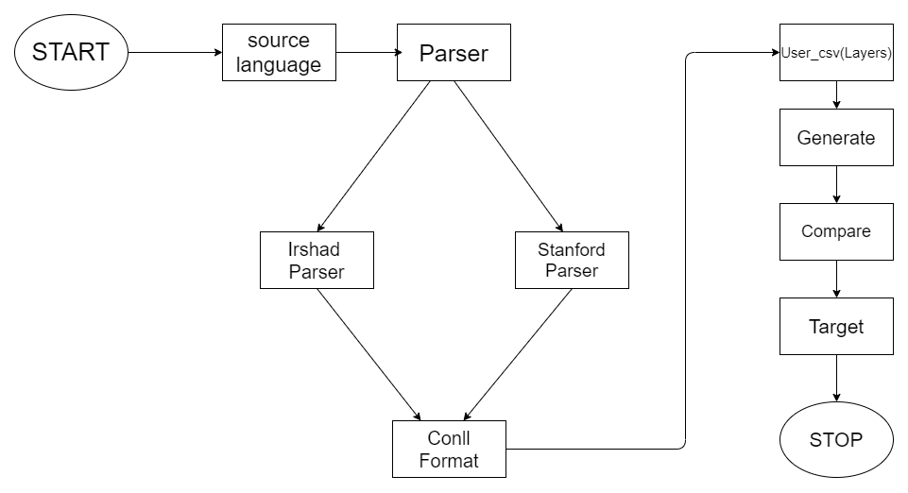
Academic Session 2019-2020
TO AUTOMATE COMPARISON OF TREES GENERATED FROM NATURAL LANGUAGE USING PARSER
Name of the Students: Gaurav Bhisikar, Sagar Malik, Aditya Dale
Name of the Guide: Prof. Pooja Walke
Industry based project at IIIT, Hyderabad
ABSTRACT : The project is to automate comparison of trees generated using Parser. Communicator tool is an authoring tool which uses Parser at one stage i.e. Irshad and Stanford parser for generating the trees and output is in Conll format which is given as a input to user csv. If user enters a sentence in one language then the tool will provide the generation of the given sentence in many languages.
INTRODUCTION:
In the thesis we have proposed an authoring tool for writing in one’s own language which can be converted to other target languages through the meditation of a controlled language which is very close to the source natural language. The tool will work by combining the language resources,multiple dictionaries and usr modules. These resources will be made by using Python and clips.
The input that Language Communicator takes is semantically disambiguated and user verified. This tool uses Irshad and Stanford Parser for comparing the trees and output is in Conll format which is given as a input to user csv. By using the generated CONLL file a tree is generated. Automatic comparison of this trees is done, which highlights the grammatical errors in the tree. A parser takes input in the form of a sequence of tokens or program instructions and usually builds a data structure in the form of a parse tree or an abstract syntax tree.
SYSTEM ARCHITECTURE:
MODULES:
1.Parser(IRSHAD & STANFORD)
APPLICATIONS:
Toolbox will be used in IIIT-H Labs.
To overcome the language barrier and it should be the part of school curriculum.

Slide 2
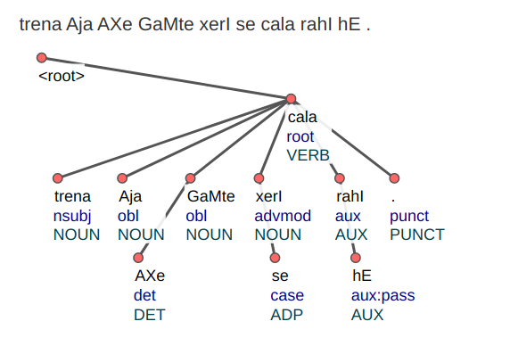
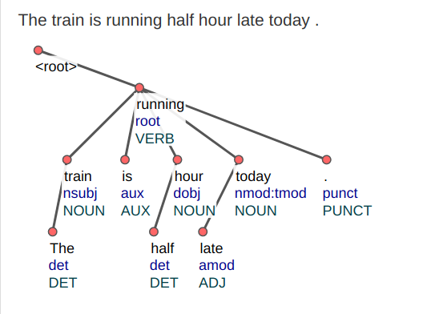
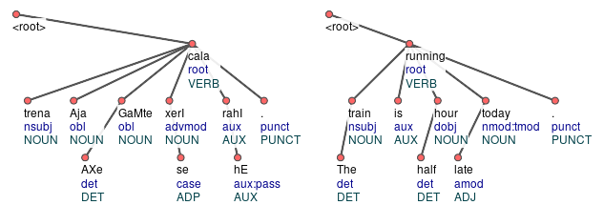
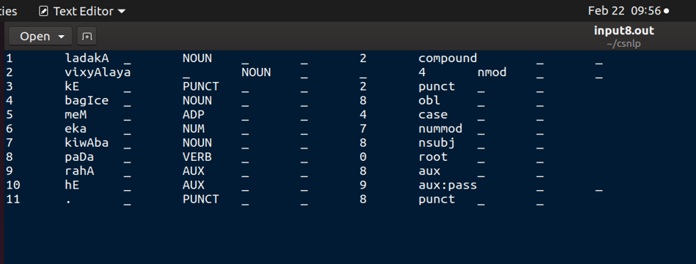
IMPLEMENTATION:
Fig. A) Hindi Tree
Fig. B) English Tree
Fig. C) Comparison of Trees
Fig. D) Conll Format
It is the Tree of Hindi Sentence generated from the Conll format generated Irshad Parser.
It is the Tree of English Sentence generated from the Conll format generated Stanford Parser.
Comparison of Irshad and Stanford parser.
The "CONLL" file type represents a corpus with one word per line, each word containing 10 columns with information about the word
REQUIREMENTS:
Hardware - Processor : Intel Celeron or higher, RAM : 512 MB Ram or higher, Disk Space : 1 GB of free disk space
Software - Ubuntu, Python 3 or above , Ace Parser , Google Spreadsheets
CONCLUSION:.
Conclusion : The phase of development of Communicator tool for automatic comparison of trees is well performed .It attempts to give birth to a new efficient system that generate more accurate output which satisfies the current needs of the user. .
REFERENCES:
[1] Sriram Chaudhary, “Anusaaraka: An Expert System based MT
System” , Published 2010.
[2] Akshar Bharati, “Anusaaraka: Overcoming the Language Barrier in
India”, appeared in “Anuvad”, Published: New Delhi, 200.”

